Slide 1
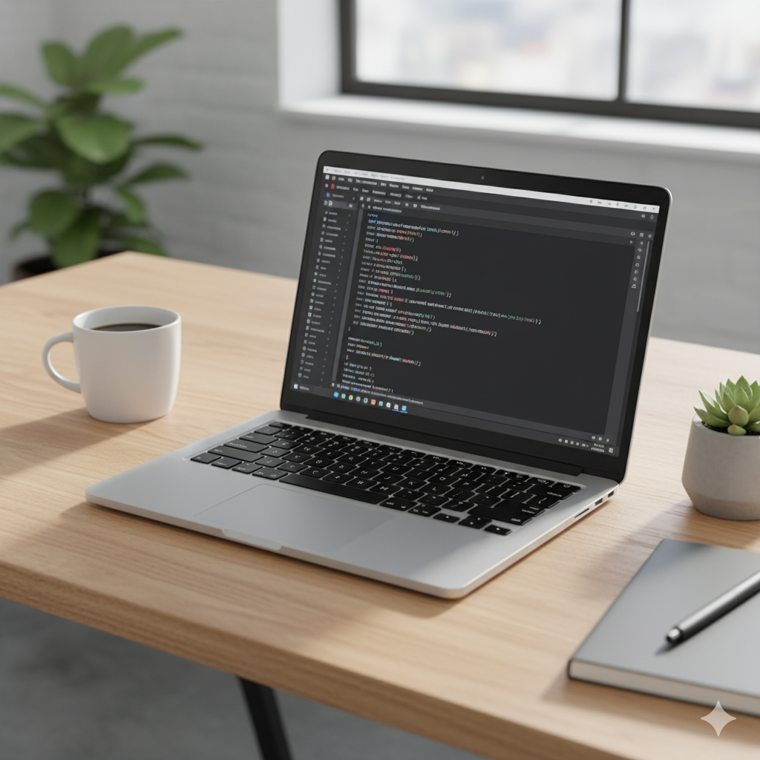
Professional Portfolio Website
Presented by: Shaurya Seth
Program: Web Development with React
Institution: Anudip Foundation
Date: October 8, 2025

Slide 2

Introduction & Objective
Project Overview:-
To design and develop a modern, fully responsive, and professional portfolio website to showcase my skills, projects, and technical experience to potential employers. It was built from the ground up using a modern frontend stack centered around React.js and Tailwind CSS.
Technical Objectives:-
To implement a robust, component-based architecture for maximum code reusability and maintainability.
To develop a fully responsive user interface that provides an optimal user experience across all devices.
To create a data-driven system for dynamically rendering project information, making the content easy to update and scale.

Slide 3
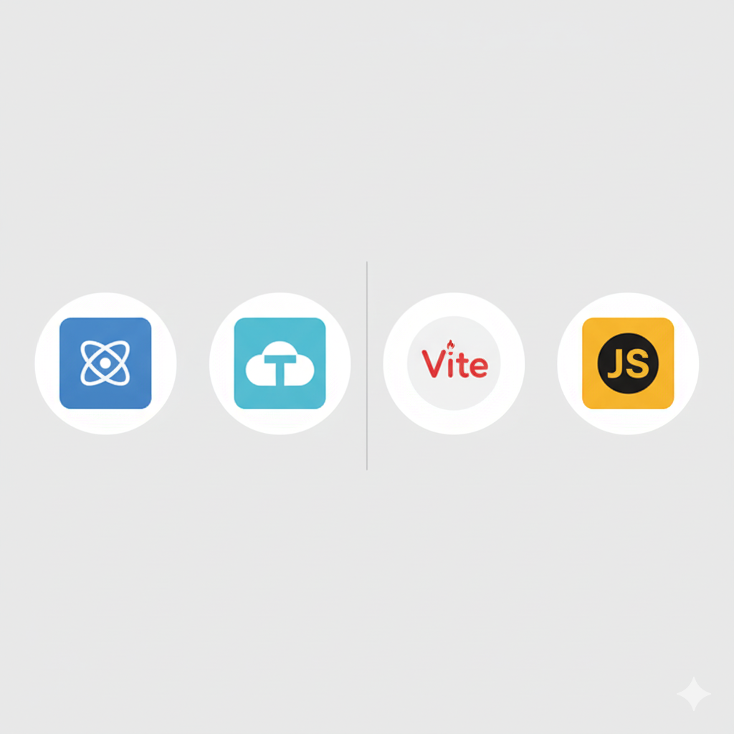
Architecture & Technology Stack
Core Architecture:
Component-Based: The application is built as a tree of reusable React components. Each section (Navbar, Home, About) is a distinct component, and elements like project cards are modular and reusable.
Frontend Technology:
React.js: The core library for building the dynamic user interface and managing application state.
HTML5 & JavaScript (ES6+): Used for structuring the application and implementing all client-side logic and interactivity.
Styling Strategy:
Tailwind CSS: A utility-first CSS framework was chosen for its ability to enable rapid, consistent, and highly customizable responsive design directly within the JSX.
Build & Deployment:
Vite, Git & GitHub, Formspree .

Slide 4
Key Features & Sections
Fully Responsive Design: Ensures a seamless and visually appealing experience on all devices, from mobile phones to desktops.
Component-Based Architecture: Built with reusable React components for maintainability and scalability.
Dynamic Project Showcase: A dedicated section to display my projects, with individual cards showing details, technologies used, and a direct link to the source code.
Fixed Navigation: An intuitive navbar that remains fixed at the top for easy navigation between sections.
Functional Contact Form: An integrated, secure contact form that allows visitors to send messages directly to my email.

Slide 5
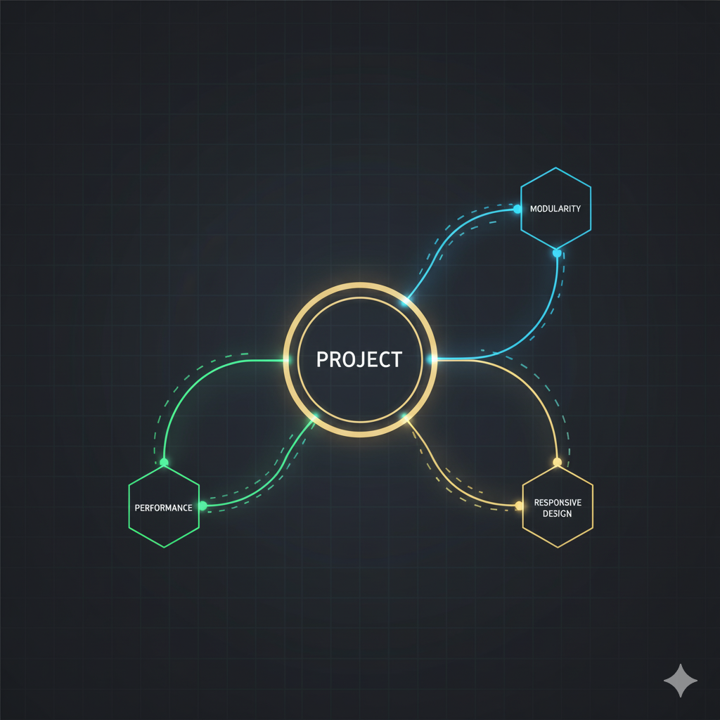
Learning Outcomes
Technical Skills Mastered:
Building and managing a complete single-page application using React.js.
Advanced responsive web design with Tailwind CSS.
Practical application of modern JavaScript (ES6+) and frontend tools like Vite.
Proficient use of Git and GitHub for version control.
Professional Growth:
This project significantly improved my problem-solving abilities, project management skills, and attention to detail in web devlopment.
Impact of Anudip Foundation Training:
The hands-on training provided me with the essential foundation and confidence to tackle real-world development challenges and successfully complete this major project.

Slide 6
Conclusion & Thank You
Project Summary
This portfolio successfully meets the goal of creating a modern, functional, and professional online presence.
Live Demo & Source Code
The project is hosted on GitHub: github.com/Shaurya99t/Anudip_Major_project
Future Scope
Integrate a CMS to manage project and blog content dynamically.
Add a dedicated blog section to share insights and tutorials.
Acknowledgements
I would like to extend my sincere gratitude to the Anudip Foundation and my instructors Aisha Ma’am for their invaluable guidance and support.

